Slide 1
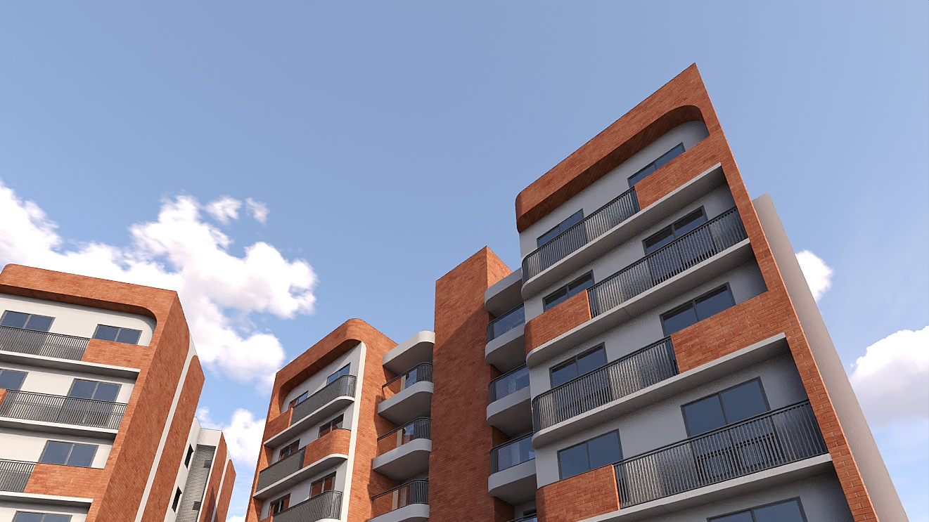

JANKI BLISS
Plans and Views

Slide 2
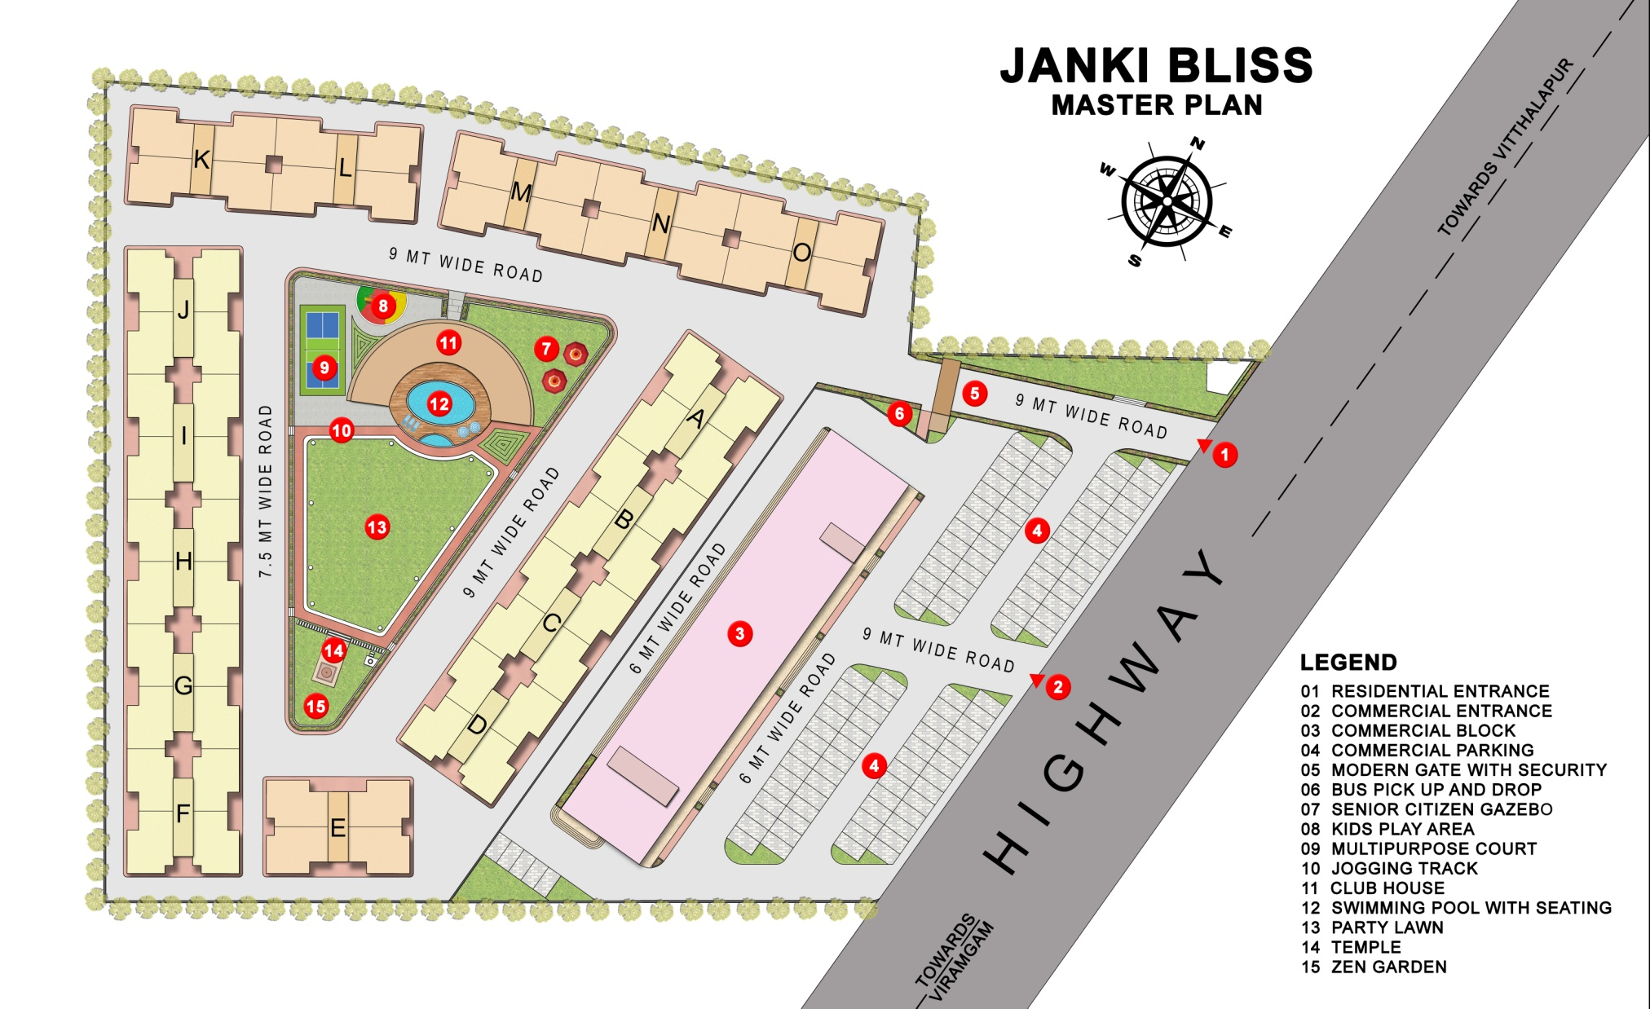
M
A
S
T
E
R
P
L
A
N

Slide 3
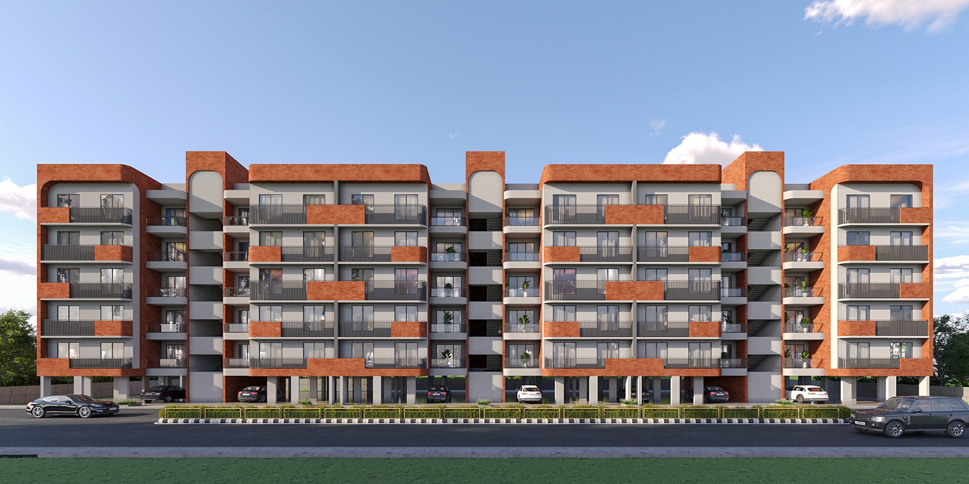
Front View

Slide 4
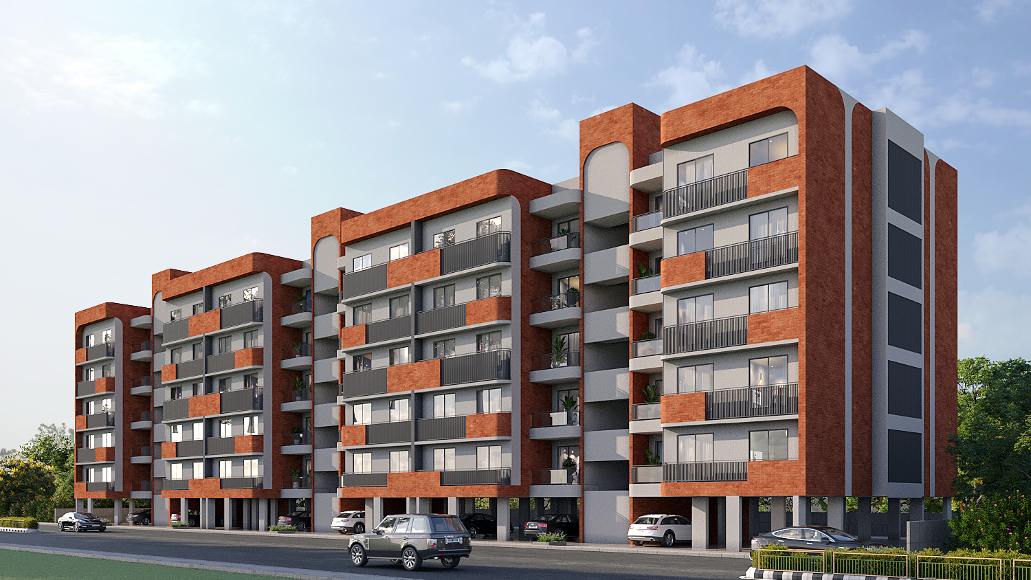
Isometric View

Slide 5
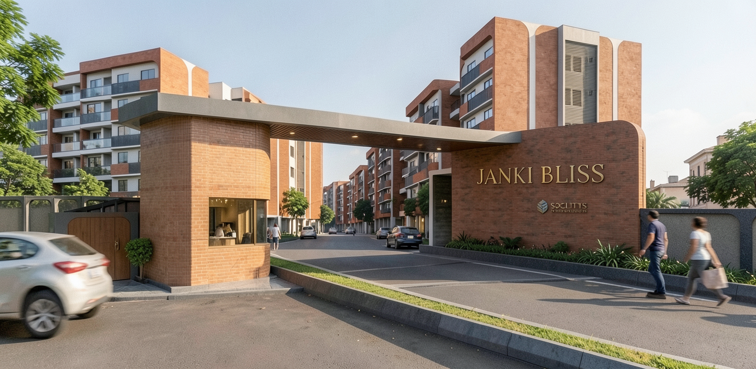
Aesthetic Main Gate; Exclusive Entrance

Slide 6
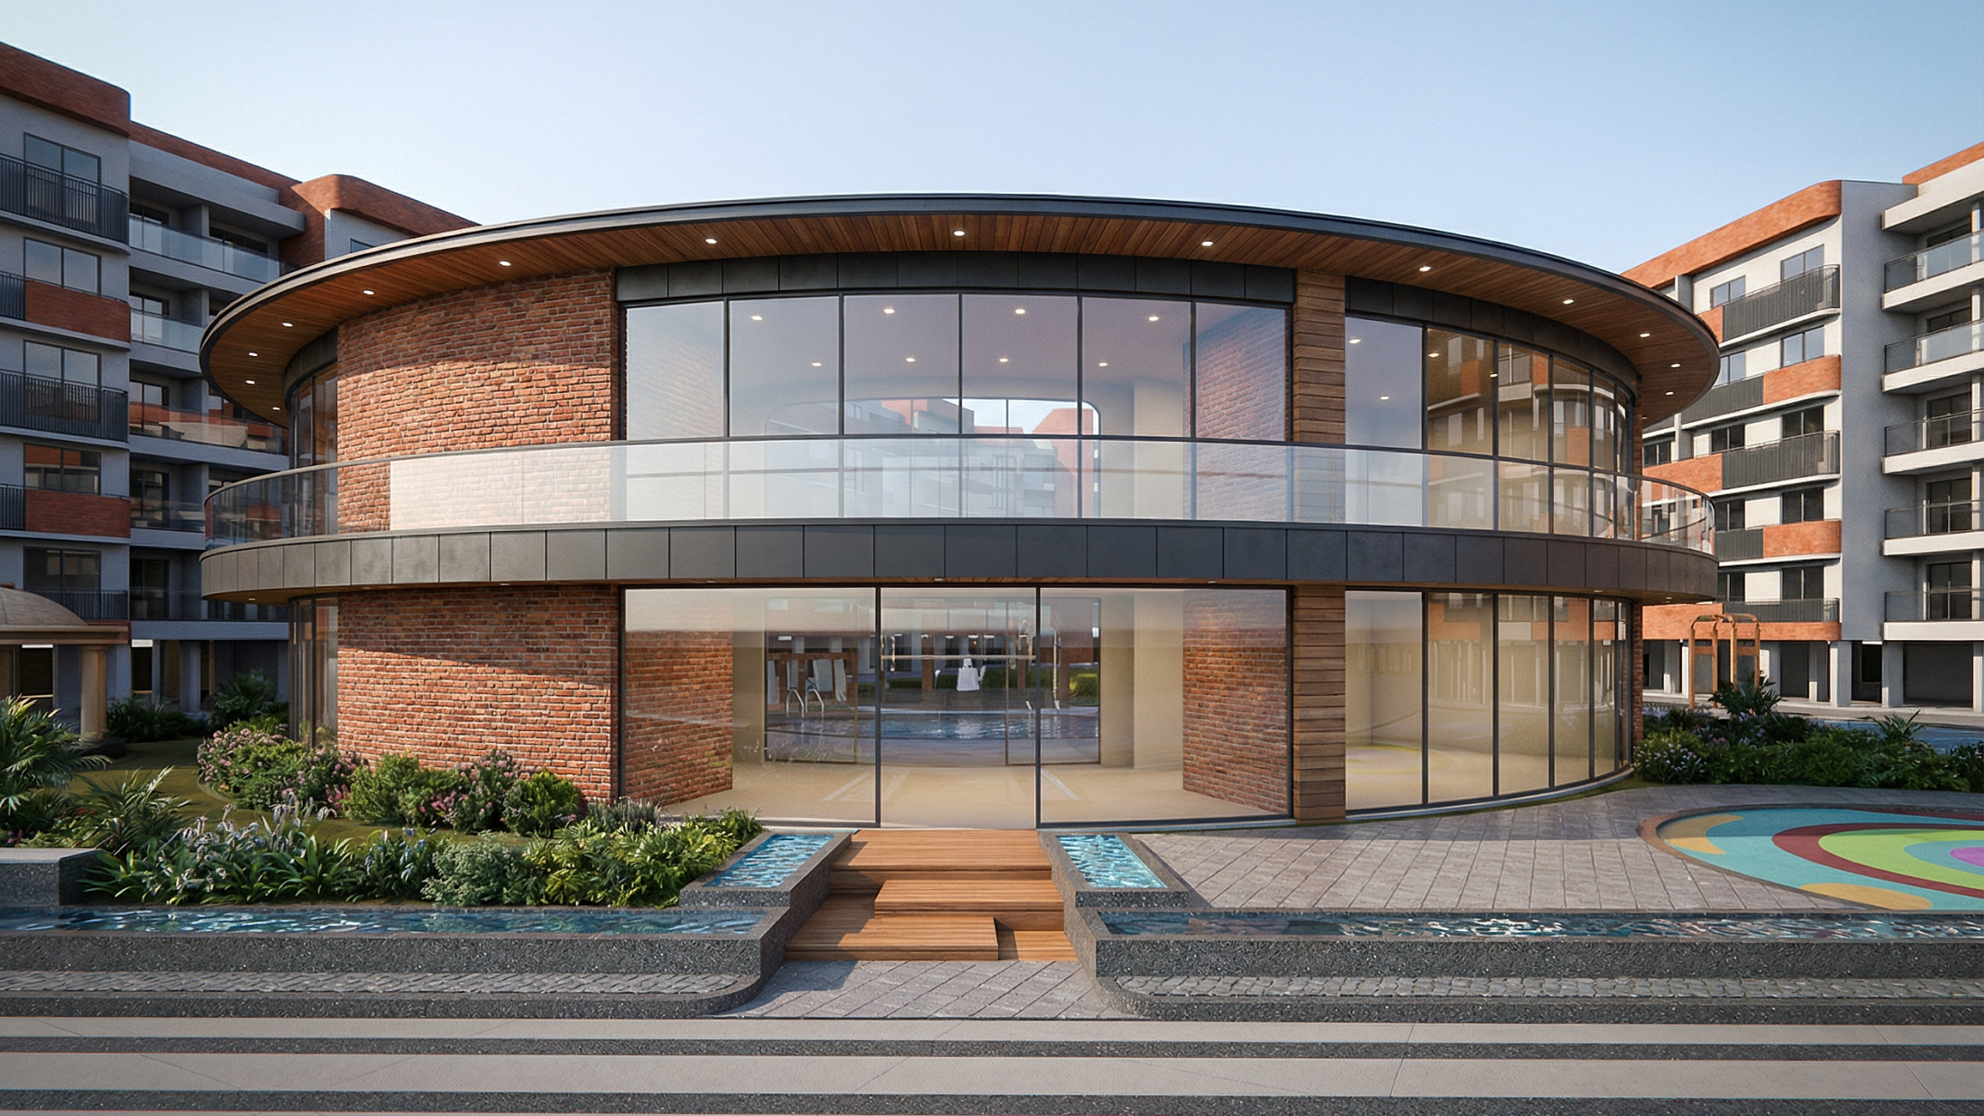
CLUB HOUSE

Slide 7
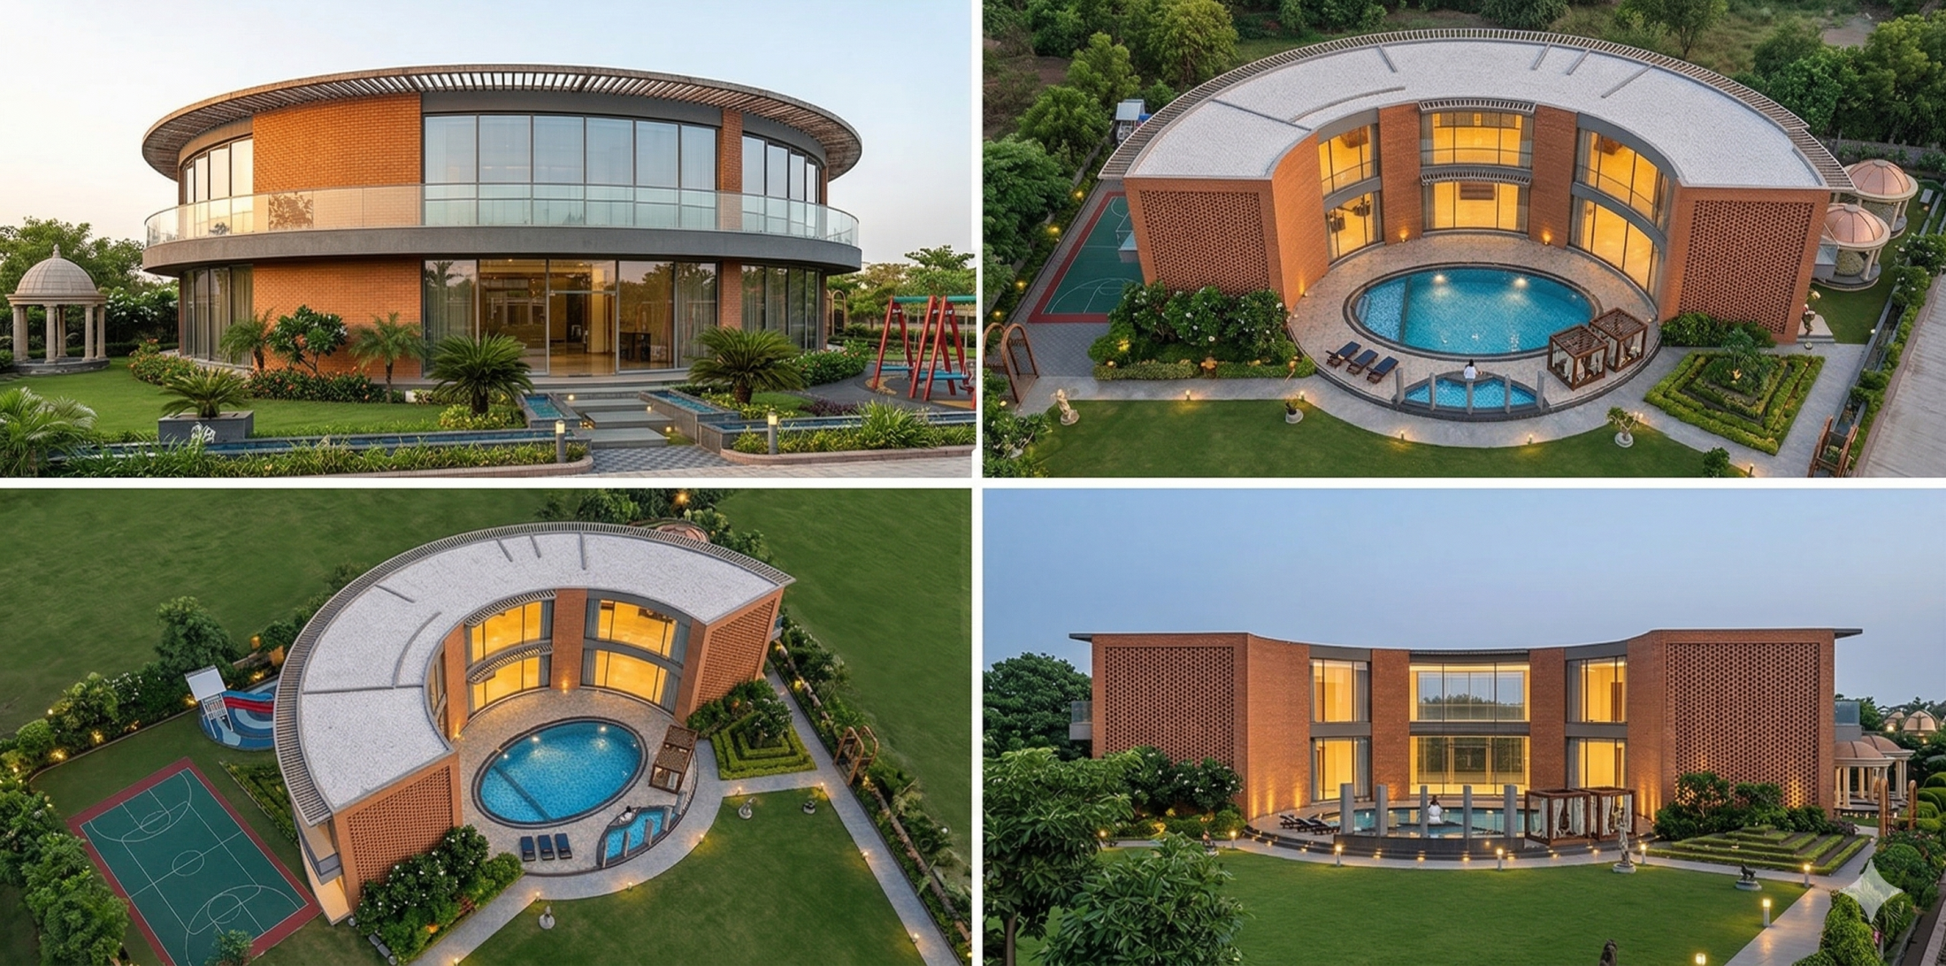
Library, Crech, Gym, Indoor Games and Theater

Slide 8
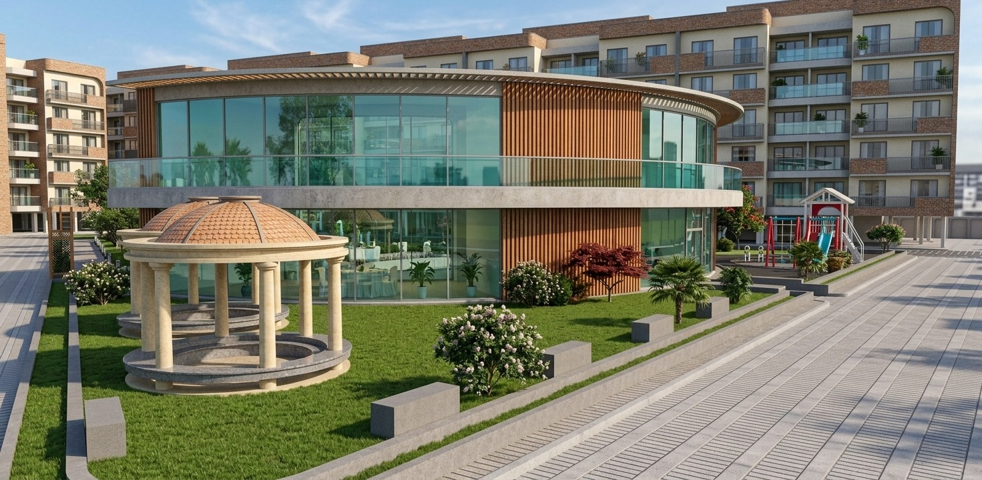
Senior Citizen Seating

Slide 9
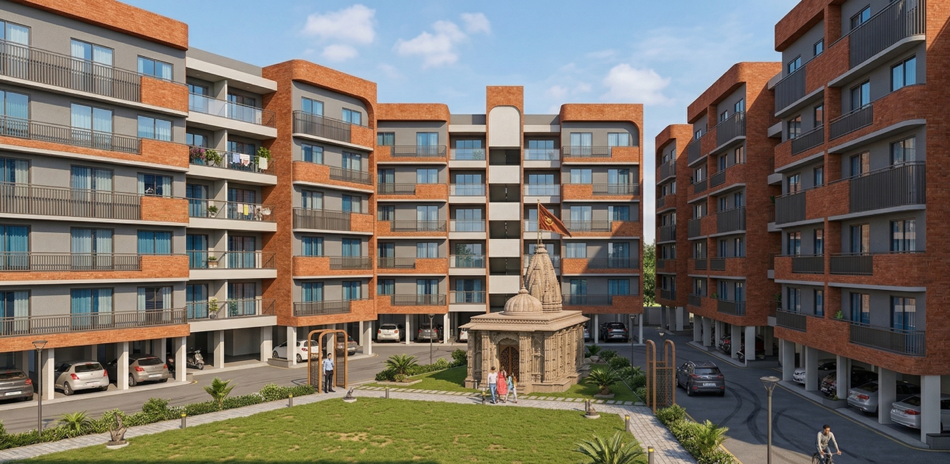
Temple and Party Lawn

Slide 10
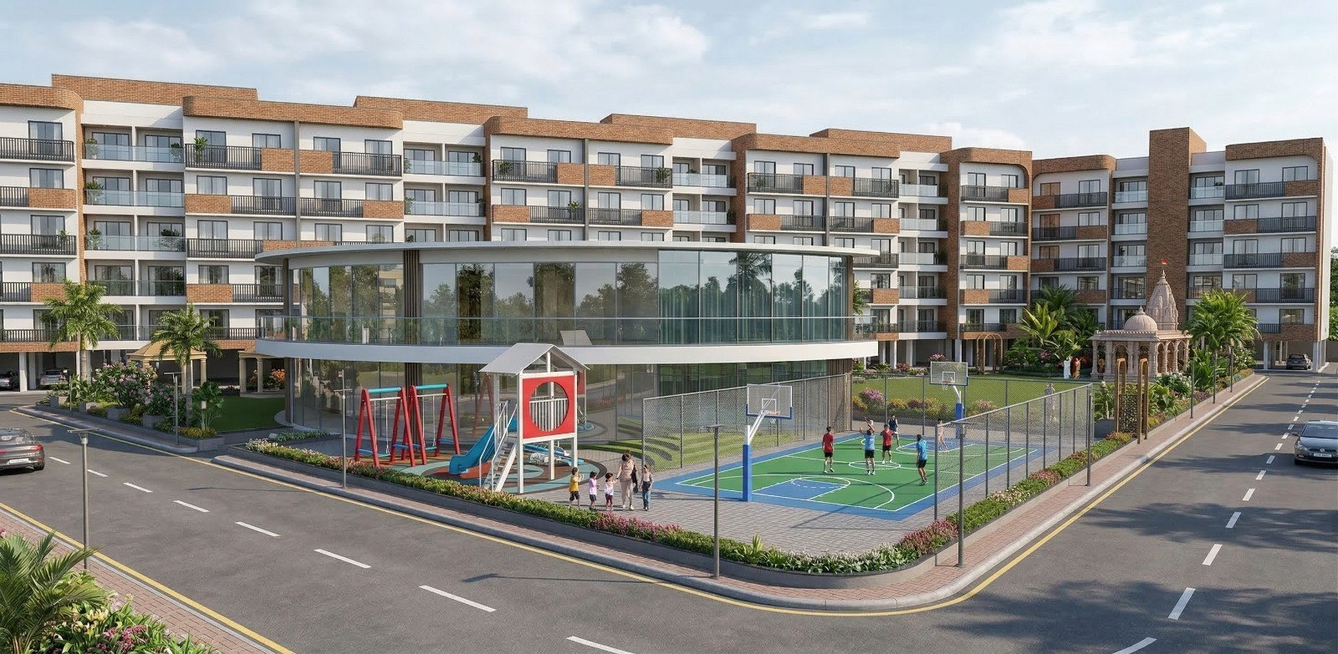
Kids Play Area and MultiSports Court

Slide 11

Thank You
A4 - 201,Iscon Flower,
Nr Laal Gebhi Ashram,
Bopal Ghuma Road, Bopal
Ahmedabad ,Gujarat
Mobile:08758514058
E-mail: contact@hgcgarchitects.com

